Slide 1




Coronary Artery Disease
Kevina Desai

Slide 2
Objectives
Understand what coronary artery disease (CAD) is
Understand the pathophysiology of CAD.
Know the common signs and symptoms of CAD and
Explain the nursing care of patients with CAD and identify proper nursing diagnosis associated with CAD
Review treatment for patients diagnosed with CAD

Slide 3
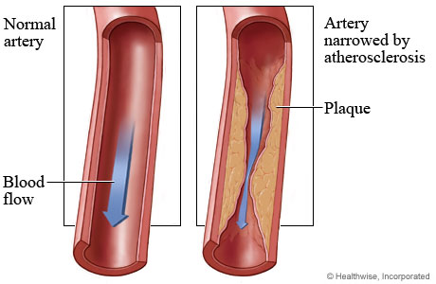
What is CAD?
Plague build up in the arteries
Plague is made up of cholesterol deposits
Atherosclerosis
Plague build up causes angina, heart failure, arrhythmias, heart attack
Overtime, CAD will weaken the heart muscle
Notes:
Coronary artery disease occurs when a substance called plaque builds up in the arteries that supply blood to the heart (called coronary arteries). Plaque is made up of cholesterol deposits, which can accumulate in your arteries. When this happens, your arteries can narrow over time. This process is called atherosclerosis.
Plaque buildup can cause angina, the most common symptom of CAD, because the heart muscle doesn't get enough blood. Over time, CAD can weaken the heart muscle. This may lead to heart failure, a serious condition where the heart can't pump blood the way that it should. An irregular heartbeat, or arrhythmia, can also develop.
For some people, the first sign of CAD is a heart attack. A heart attack occurs when plaque totally blocks an artery carrying blood to the heart. It also can happen if a plaque deposit breaks off and clots a coronary artery.
(Gao, Xu & Shi, 2012)

Slide 4
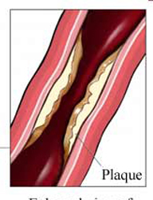
Pathophysiology
Chronic Process
Endothelial Injury
Fatty Streaks
Lipid Deposits which calcify over time
Platelets and smooth muscle proliferation(reproduce rapidly, increase greatly)
Unstable Plague
Collateral Circulation
Notes:
Chronic process that begins during adolescence and slowly progresses throughout life. Observed by age 15 and increase with age. Believed to be reversible.
Endothelial injury predisposes to lipid deposits(plague) and platelet activation
Fatty streaks: streaks of fat develop in the smooth muscle cells of the blood vessel—turn yellow.
Platelets release growth factors cause smooth muscle proliferation which further traps lipids.
(Huether, S. E., & McCance, K. L., 2012)

Slide 5
Prevalence
The National Center for Health Statistics 2011 Report
Cardiovascular disease remains the leading cause of mortality in the United States in men and women of every major ethnic group
It accounted for nearly 616,000 deaths in 2011
CAD is the most common type of heart disease
Every year, approximately 785,000 Americans suffer a first heart attack and another 470,000 will suffer an additional myocardial infarction (MI)
In 2010, CAD alone was projected to cost the U.S. $108.9 billion including the cost of health care services, medications, etc.
Notes:
http://www.cdc.gov/heartdisease/coronary_ad.htm
(Rimmerman, 2011), (Gao, Xu & Shi, 2012)

Slide 6
Risk Factors
Unmodifiable
Age
Gender
Ethnicity
Genetic Inheritance
Modifiable
Elevated serum cholesterol
Hypertension
Smoking
Obesity
Diabetes
Notes:
Unmodifiable: these are things we cant control
with Genetic Inheritance, if your asking questions and they say their family has a history of it, you always want to ask the age of onset
Modifiable: Elevated serum cholesterol of more than 200mg/dl associated with risk of developing CAD.
Risk of developing CAD is six times higher in smokers than non-smokers. Risk is proportional to the number of cigarettes smoked.
As obesity increases, the heart grows in size, causes increased myocardial oxygen consumption.

Slide 7
Signs/Symtoms
Angina pectoris,
Unstable angina pectoris,
Myocaridial Infarction (MI)
Cardiac dysrhythmias
Chest discomfort
Discomfort in the arm, throat, or jaw
Heartburn
Shortness of breath
Asymptomatic
Notes:
Many patients have no symptoms at all.
Those that do might find it difficult to recollect and describe the exact symptoms, aggravating/alleviating factors, and duration especially when OLDCARTing their pain.
(Gao, Xu & Shi, 2012)

Slide 8
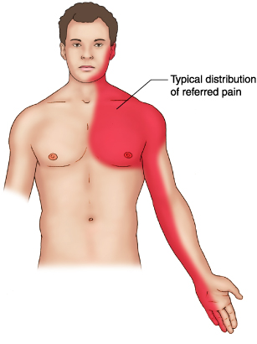
Anginal Pain
Stable and Unstable
Usually substernal pressure.
May radiate to arm or jaw.
May be associated with diaphoresis or dyspnea.
Atypical presentations
  Females
  Diabetics
  Elderly
Notes:
Stable: does not occur at rest
Unstable: Acute Coronary Syndrome (ACS) happening at rest
Atypical: not usual- Silent Heart attacks
less pain may be fatigue, weakness, dizziness, dyspnea.
Angina is patient specific

Slide 9
Treatment of Angina
Risk factor modification
Antiplatelets
Statins
Nitroglycerin
Β-Blockers
Calcium Channel Blockers
Possible PTCA or CABG

Slide 10

Myocardial Infarction
“Heart Attack”
Complications:
  Arrhythmias
  Chronic Heart Failure
  Cardiogenic Shock
  Pericarditis
  Pulmonary Embolism
  Papillary Muscle Dysfunction
  Ventricular Aneurysm
STEMI
  ST elevation on a ECG
NSTEMI
  Heart attack without ST elevation on a ECG
Notes:
Most common complication following MI is arrhythmias which are present in 80% of MI patients. The most common cause of death usually V-fib
CHF: pumping action of the heart is diminished. Inadequate CO(isnt meeting demands of CO of body) and pulmonary edema.
Cardiogenic shock: severe LV failure, renal failure, worsened myocardial ischemia.
Pericarditis may occur 2-3 days post-MI as a complication of infarction. S/S: Chest pain aggravated by inspiration, coughing, and upper body movement. Pain relieved by sitting in a forward position. Heard as a friction rub. Best heard with diaphragm of stethoscope over lower sternal border. ST-T wave elevations on ECG indicating inflammation. Tx: ASA, steroids, or NSAID’s.
PE: due to immobility. Source may be leg veins or the damaged endocardium.

Slide 11

Treatments for:
STEMI
NSTEMI
Emergent PCI (PTCA
Thrombolytics
Admit to CCU.
Bedrest.
Continuous monitoring.
Assess for complications.
Heparin/LMWH
Beta Blockers
Consider PCI (PTCA) or CABG

Slide 12
PCI (PTCA)
  Percutaneous transluminal coronary angioplasty(PTCA)
Alternative to surgical intervention
Catheter is inserted with balloon on end
Pros:
  ambulatory after
  procedure
  decreased length of
  hospital stay
Cons:
  dissection of dilated artery causing death
  cardiac tamponade,
  ischemia and MI
  allergic reaction to dye

Slide 13
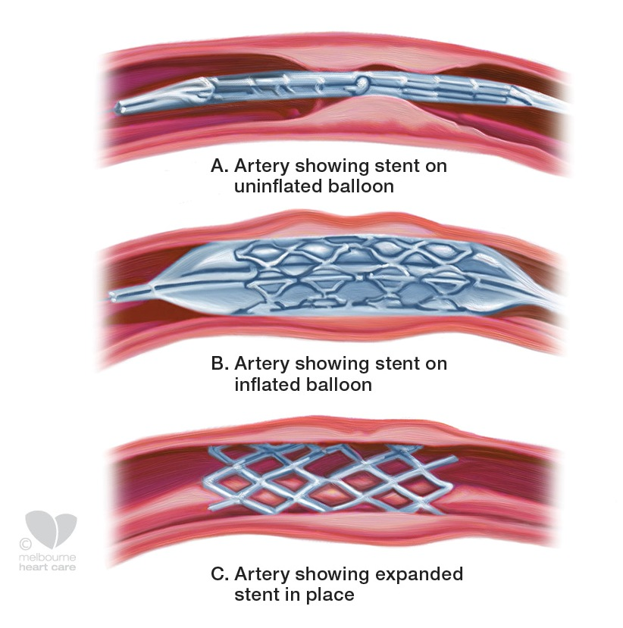
PCI (PTCA)

Slide 14
CABG
A healthy artery or vein from the body is connected, or grafted, to the blocked coronary artery
The grafted artery or vein bypasses the blocked portion of the coronary artery
CABG may be an option if you have blockages in the heart that can't be treated with a stent
Goals of a CABG
  Improving the pumping action of your heart
  Improving your quality of life and reducing angina and other CAD symptoms
Notes:
(The National Heart, Lung, and Blood Institute (NHLBI), 2012)

Slide 15
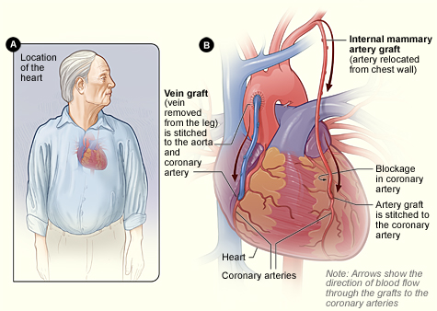

Slide 16
What to include in a History
Current symptoms
Complete list of comorbid conditions
Complete Family History
  How closely are they related?
  Age of diagnosis for that relative
Character and Location of discomfort
Radiation of discomfort
Associated/Aggravating/Alleviating symptoms
Notes:
(Gao, Xu & Shi, 2012)

Slide 17
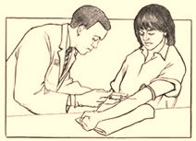
Important Labs
Glucose
Lipid Levels
  Total cholesterol
  high-density lipoprotein [HDL]
  Low--density lipoprotein [LDL]
  Triglycerides
High-sensitivity C-reactive protein
Troponin levels
Notes:
High-sensitivity C-reactive protein is assessing the inflammatory level of vascular disease and predicting future risk of vascular events, like MI’s and strokes
Troponin are what we use to determine cardiac muscle damage-if you have STEMI you have positive troponin,
(Centers for Disease Control and Prevention CDC, 2009)

Slide 18
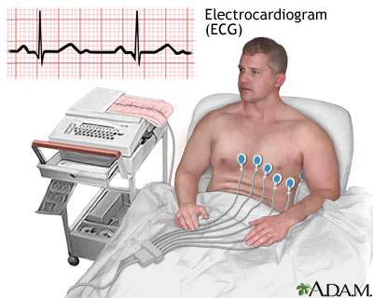
Important Tests
ECD or EKG (electrocardiogram)
Echocardiogram
Exercise stress test
Chest X-ray
Cardiac catheterization
Coronary angiogram
Notes:
ECD or EKG (electrocardiogram)-Measures the electrical activity, rate, and regularity of your heartbeat.
Echocardiogram Uses ultrasound to create a picture of the heart.
Exercise stress test Measures your heart rate while you walk on a treadmill. This helps to determine how well your heart is working when it has to pump more blood.
Chest X-ray Creates a picture of the heart, lungs, and other organs in the chest.
Cardiac catheterization Checks the inside of your arteries for blockage by threading a thin, flexible tube through an artery in the groin, arm, or neck to reach the coronary artery. Can measure blood pressure and flow in the heart's chambers, collect blood samples from the heart, or inject dye into the coronary arteries.
Coronary angiogram Monitors blockage and flow of blood through the heart. Uses X-rays to detect dye injected via cardiac catheterization.
(Centers for Disease Control and Prevention CDC, 2009)
(McPerson, 2012)

Slide 19
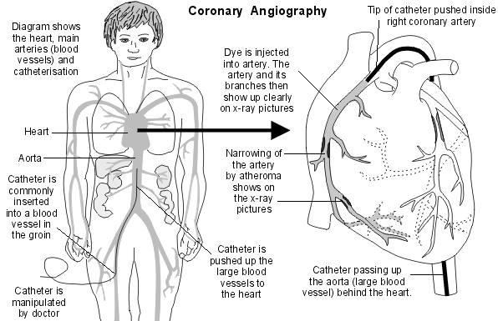
Notes:
(McPerson, 2012)

Slide 20
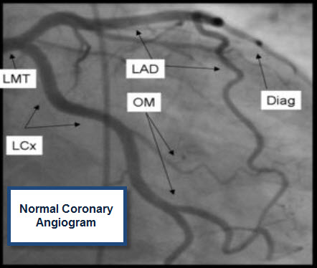
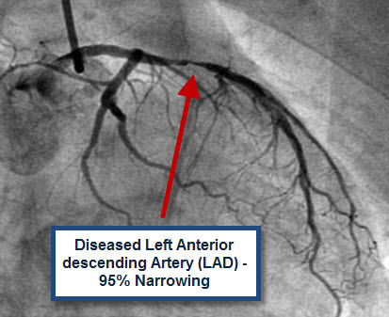
Notes:
Right Coronary Artery (RCA)
Left Main (LMA) Massive Anteriolateral. “widowmaker”.
Left Anterior Descending (LAD) Anterior wall.
Circumflex Lateral and posterior wall.
(McPerson, 2012)

Slide 21

Nursing Diagnoses
Acute Pain
  Related to cardiac ishchemia
Excess Fluid Volume
  Related to fluid retention
Activity Intolerance
  related to insufficient oxygenation
Decreased Cardiac Output
  related to dysrhythmias
Ineffective Coping
  related to decreased physical status after myocardial infarction
Notes:
(Ackley, 2010)

Slide 22
Nursing Interventions
If patient is in pain, instruct patient to notify nurse immediately of chest pain
If fluid overload, administer diuretics as ordered and teach patient rational and side effect of medication
  Weigh patient daily
  Stress importance of daily weights
If decreased cardiac output, administer and teach antiarrhythmic medications, as ordered by health care provider
If activity intolerance, encourage participation in cardiac rehab program; teach how to monitor heart rate, blood pressure, and respirations; increase endurance and strength and prevent weight gain
Notes:
(Ackley, 2010)

Slide 23
A client is scheduled for a cardiac catherization using a dye. Which of the following assessments is most critical before the procedure?
Intake and output
Baseline peripheral pulse rates
Height and weight
Allergy to iodine or shellfish
Notes:
4. This procedure requires an informed consent because it involves injection of a radiopaque dye into the blood vessel. The risk of allergic reaction and possible anaphylaxis is serious and must be assessed before the procedure.

Slide 24
A 60-year-old male client comes into the emergency department with complaints of crushing chest pain that radiates to his shoulder and left arm. The admitting diagnosis is acute myocardial infarction. Immediate admission orders include oxygen by NC at 4L/minute, blood work, chest x-ray, an ECG, and 2mg of morphine given intravenously. The nurse should first:
Administer the morphine
Obtain a 12-lead ECG
Obtain the lab work
Order the chest x-ray
Notes:
1. Although obtaining the ECG, chest x-ray, and blood work are all important, the nurse’s priority action would be to relieve the crushing chest pain.

Slide 25
Sublingual nitroglycerin tablets begin to work within 1 to 2 minutes. How should the nurse instruct the client to use the drug when chest pain occurs?
Take one tablet every 2 to 5 minutes until the pain stops.
Take one tablet and rest for 10 minutes. Call the physician if pain persists after 10 minutes.
Take one tablet, then an additional tablet every 5 minutes for a total of 3 tablets. Call the physician if pain persists after three tablets.
Take one tablet. If pain persists after 5 minutes, take two tablets. If pain still persists 5 minutes later, call the physician.
Notes:
3. The correct protocol for nitroglycerin used involves immediate administration, with subsequent doses taken at 5-minute intervals as needed, for a total dose of 3 tablets. Sublingual nitroglycerin appears in the blood stream within 2 to 3 minutes and is metabolized within about 10 minutes.

Slide 26
References
Ackley B, Ladwig G: Nursing Diagnosis Handbook: An Evidence-Based Guide to Planning Care, ed. 9, St Louis, Mosby, 2010.
Centers for Disease Control and Prevention CDC. (2009, 12 07). Coronary artery disease (cad). Retrieved from http://www.cdc.gov/heartdisease/coronary_ad.htm
Gao, Z., Xu, H., & Shi, D. (2012). Analysis on outcome of 5284 patients with coronary artery disease: The role of integrative medicine. Journal of Ethnopharmacology, 141(2), 578-583. Retrieved from http://ejournals.ebsco.com/Direct.asp?AccessToken=95X5DIJ8X49J9PJXEXE5X49J4Q598Q5MID&Show=Object
Huether, S. E., & McCance, K. L. (2012). Understanding Pathophysiology. (pg. 1052). St. Louis MS: Mosby, Inc.
McPerson, D. (2012). Inflammation and coronary artery disease: insights from genetic studies. The Canadian Journal Of Cardiology, 28, Retrieved from http://ehis.ebscohost.com/eds/detail?vid=8&sid=ad8517ad-e57d-4976-8efc-c1619413e7e8@sessionmgr112&hid=16&bdata=JnNpdGU9ZWRzLWxpdmU=
The National Heart, Lung, and Blood Institute (NHLBI). (2012, 02 23). What is coronary artery bypass grafting?. Retrieved from http://www.nhlbi.nih.gov/health/health-topics/topics/cabg/
Rimmerman, C. M. (n.d.). Coronary artery disease (cad). (2011) Retrieved from http://www.clevelandclinicmeded.com/medicalpubs/diseasemanagement/cardiology/coronary-artery-disease/
Student Nursing Study Blog. (n.d.). Coronary artery disease and hypertension. Retrieved from http://amy47.com/nclex-style-practice-questions/cardiac-mi-and-hf/cad-htn/

