Slide 1
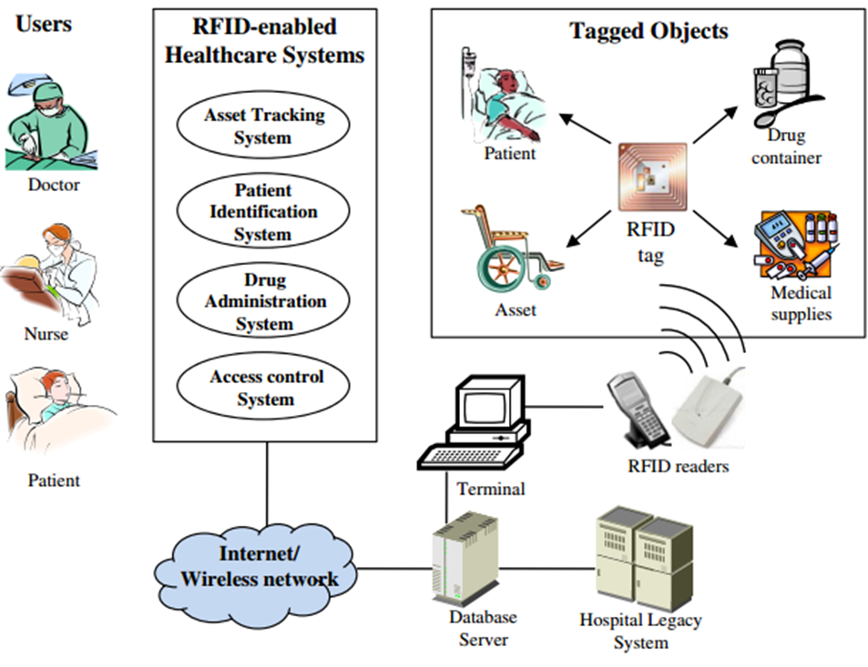
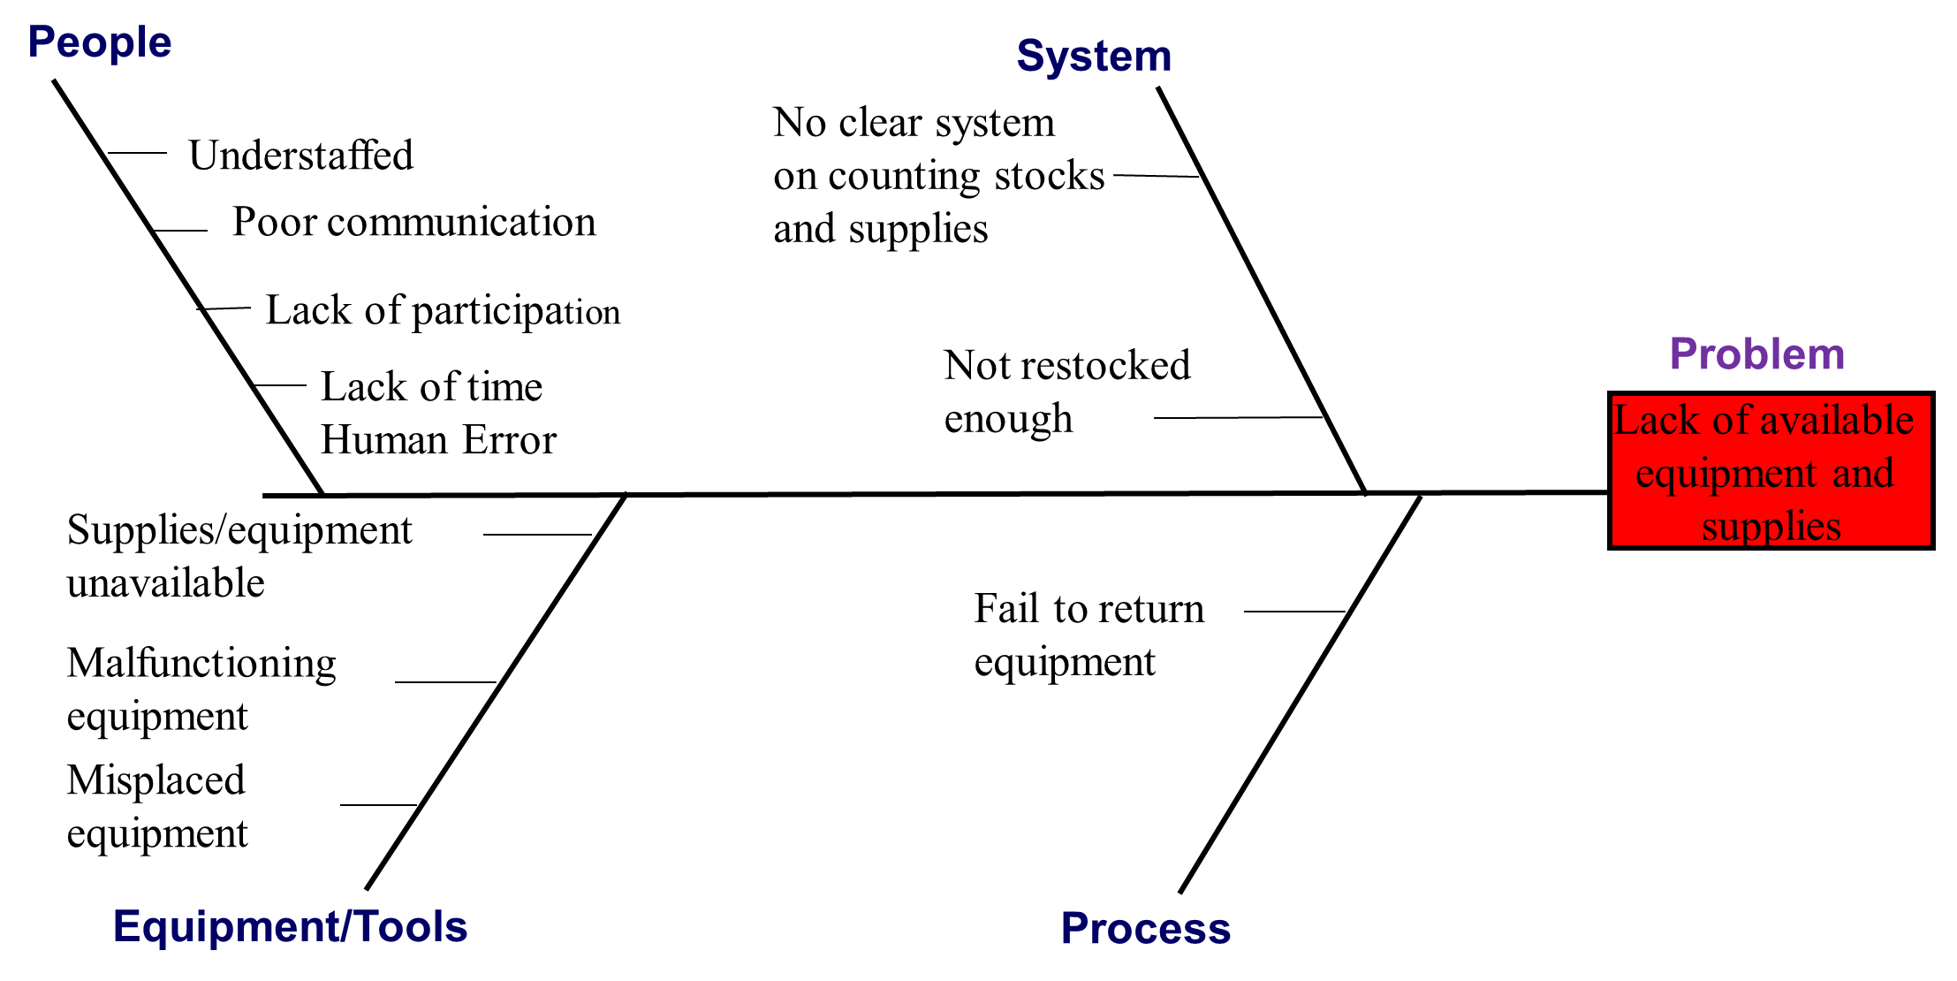
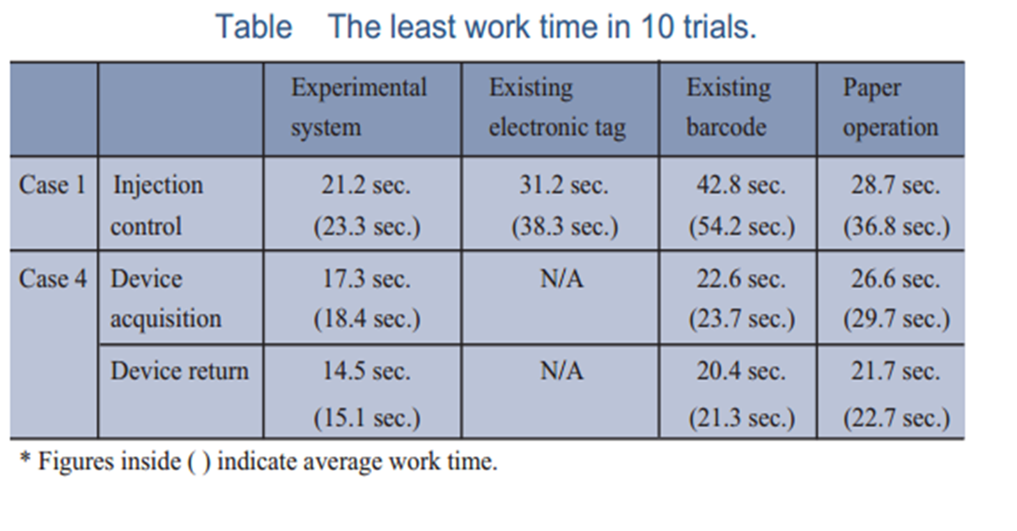
Stock Revolution
Presented by Kevina Desai, RN-BSN Student; Contributions made by Michelle Scarlett and Emma Fleck, RN-BSN Students
Figure1
Purpose
Results
Measures
The purpose of this proposed project is to reduce the time that health care providers spend looking for supplies and equipment. By using a real-time locating system, providers can save the time that is being used to search for missing supplies and equipment. The time saved can be directly spent with patients at the bedside. A more efficient work environment that is patient centered and equitable in the provision of its care equals a happier staff, which creates for happier patients (Rao, 2012).
To measure the effectiveness of the proposed improvement strategy, a pilot program will be launched.
After one month of implementation, a committee will review time spent looking for medical equipment and available equipment and supplies and measure the accuracy of the application of the RTLS (Perez et al, 2012).
By utilizing the RFTI system, we will be able to better identify the whereabouts of medical equipment and focus more of the time by spending it doing more patient care activities.
If improvement is noted, the committee will consider expanding the project.
Nurses and nurse aids will individually be accountable for returning equipment to its rightful place and to be available in the rooms of each patient for every shift (Perez et al, 2012).
Background
Difficulty allocating resources is real time that is being lost. Nurses wasted over 30% of their working time searching for supplies and equipment for their patients (Yao, Chu, & Li, 2011).
Lost equipment and supplies cost hospitals $4,000 per bed each year and with over 975,000 staffed beds in the U.S., this represents a potential loss of $3.9 billion annually (Yao, Chu, & Li, 2011).
One way to improve this problem is by the use of Radio Frequency Identification (RFID) technology. RFID offers tracking capability to locate equipment, supplies and people in real time using tags and readers. It is used to track individual items in order to better control inventory (Yao, Chu, & Li, 2011).
Process Improvement
The unit will use the RFID and tag all movable equipment for tracking.
RFID tags on all items will make the visual inventory counting procedure unnecessary. As items are removed from inventory by a nurse or other personnel, the items are automatically recorded as leaving inventory.
Limitations / Lessons Learned
Improvement Tools/Methods
The barriers associated with this proposed project are wireless signals to provide exact location, cost of maintenance such as tag replacement, and IT and database support.
Getting staff to participate and be responsible in their role during the improvement process. Each individual team member would also be responsible for the training needed to become familiar with RFID.
RFID is not the only method to solve this issue, but is a consideration that can be made to help improve this problem if implemented.
Staff education (RN, LPN, and CNA) will be performed to introduce the project.
The fishbone diagram [see below] can be used to educate health care providers by illustrating the lack of supplies and equipment and demonstrate how hard it is to find it.
Using the RFID, supplies and equipment that are missing or dislocated will be able to be located with the use of radio frequency to reduce the time that is being spend looking for the items that could be directly spent with the patients.
References
Team Members
Perez, M., Cabrero-Canosa, M., Hermida, J., Garcia, L., Gomez, D., Gonzalez, G., & Herranz, I. (2012). Application of RFID Technology in Patient Tracking and Medication Traceability in Emergency Care. Journal Of Medical Systems, 36(6), 3983-3993.
Rao, G. (2012). How Can We Improve Patient Care?. Community Eye Health, 15(41). Retrieved from http://www.ncbi.nlm.nih.gov/pmc/articles/PMC1705904/.
Takatama, H., Ishizuka, E., Hara, A., Onoda, Y., Wantabe, M., & Kondoh, K. (2008). General format. Retrieved from http://www.nec.com/en/global/techrep/journal/g08/n03/pdf/080323.pdf
Yao, W., Chu, C., & Li, Z. (2011). The adoption and implementation of RFID technologies in healthcare: A literature review. Journal of Medical Systems, 36(6), 3507-3525.
Nurse Manager
Charge nurse
Information systems
Engineers
Finance
Nursing staff
Material Management
Environmental Services
IT
A study done at Akita University Hospital showed that those that work in a setting with RFID’s required less time looking for medical equipment and supplies making it more efficient at work (Takatama et al., 2008).
Progressive Care Unit: Florida Hospital of Tampa

